Slide 1



Terminal, Git/Github, LaTex/zotero
IAP 15.S60 Session 1
Lisa Everest

Slide 2
Today’s Learning Objectives
Describe the importance of reproducibility in coding projects
Enter basic commands in terminal to navigate a file system, manipulate files, and run scripts
Maintain proper version control for a coding project using git
Collaborate on a coding project with Github
Share your research work and maintain bibliographies through Latex and Zotero
Accessing journal papers through MIT

Slide 3
Agenda
Reproducibility and Terminal (30 mins)
Git (1 hr)
Break
Github (1 hr)
LaTeX and Zotero (15 mins)
Journal papers (15 mins)

Slide 4
Reproducibility
Motivation for today’s class
Adapted from slides by Sam Gilmour and the Turing Way

Slide 5
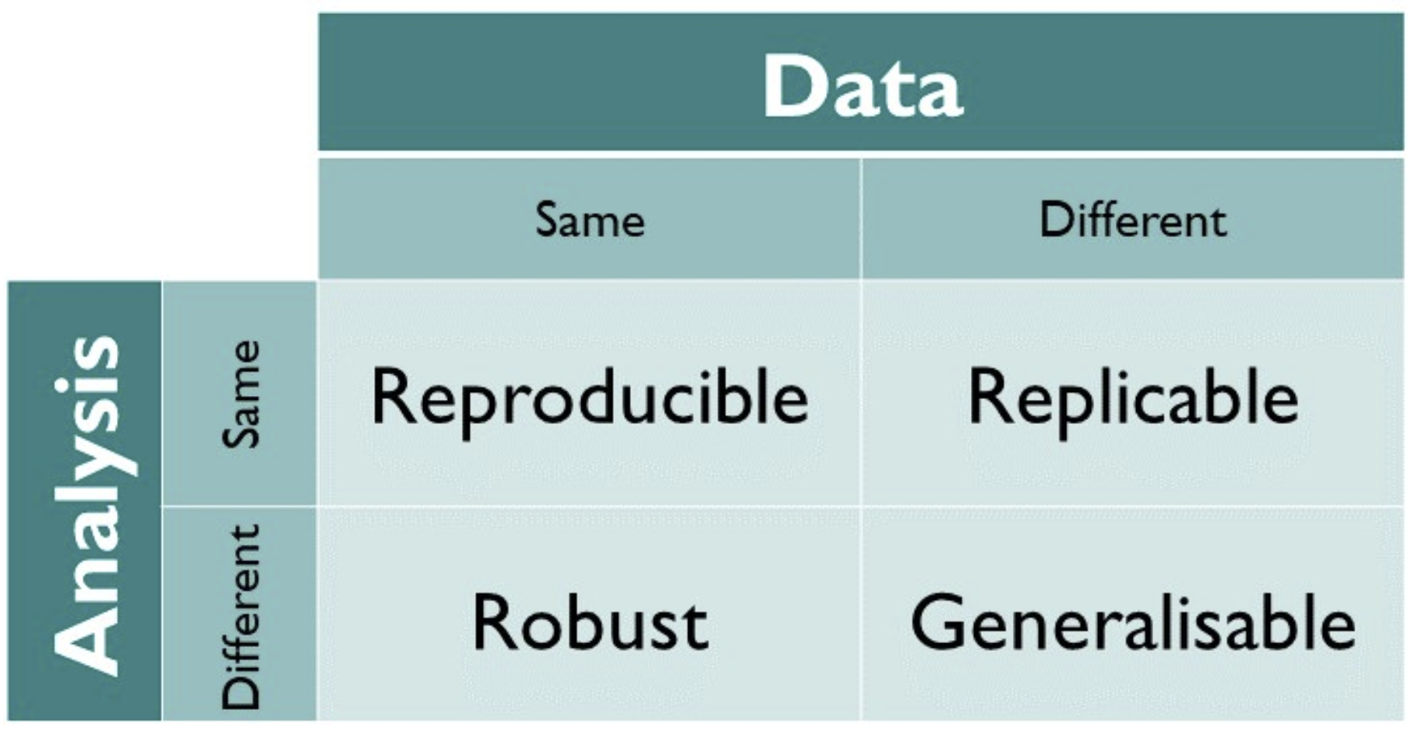
What is reproducibility?
“The ability to obtain consistent results no matter the machine a project runs on.”

Slide 6
One possible reproducibility nightmare
Imagine you created a new optimization model and algorithm for a problem and ran many computational experiments without keeping in mind reproducibility.
Months later, you finish writing your paper on it and stumble upon on a new model that was wayyyyy better and faster. Welp… Time to re-run everything!
Spend a day trying to get code set up to run again
But new results didn’t match up with original results
Eventually, you track down a single parameter that had changed
Change the parameter and re-run everything again
Would take weeks of work and huge amounts of cluster resources

Slide 7
Think-Pair-Share Activity
Think about a non-reproducible or non-auditable workflow you have used before at work, in research, on a personal project, or in coursework that negatively impacted your work somehow (2 minutes)
Pair with the person beside you and share your story and how it negatively impacted you (3-4 minutes)
We’ll come back together as a class and share a few stories

Slide 8
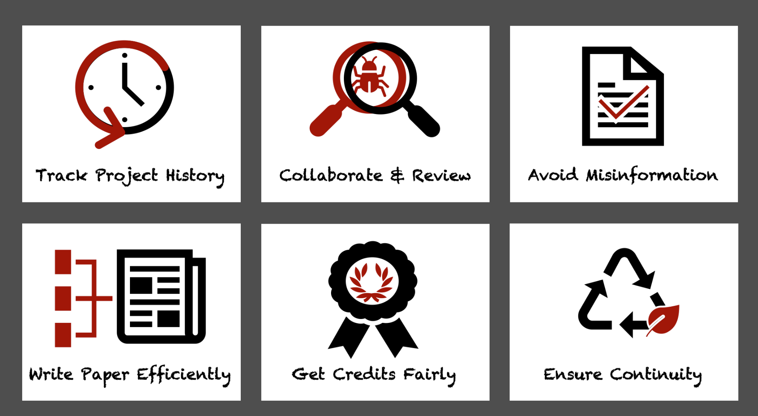
What is reproducibility good for?

Slide 9



Failure Case
Clinical trials for 110 cancer patients hoping to identify personalized treatments based on gene signatures
Strong results, high-impact publications
Experts find errors in analysis
Excel formula errors
Poor documentation
Trials terminated,
25 papers retracted

Slide 10
Tools for reproducibility
Version control – maintain a history of your project to better track changes and decisions
Testing – simple tests to detect errors and changes in functionality when new features are added
Maintaining a reproducible computational environment – for example, software and package versions
Making code and data open and available when possible

Slide 11
Another Think-Pair-Share
Think about barriers that prevent you (or may prevent others) from using a reproducible and auditable workflow. What makes reproducibility a hard standard to meet? (2 minutes)
Pair with the person beside you and share 1-2 things that might make reproducibility hard for you or others (2 minutes)
We’ll come back together as a class and share some ideas
Notes:
If I share my code, people might find mistakes
Takes time!!
I don’t know how

Slide 12


Tools for Reproducible Research
Git - Version control system
Command line tool
Used to make and document local code changes (and communicate those changes with Github)
Github - Hosting platform for version control and collaboration
Widely used by developers to store their projects
Easily share code and data, privately and publicly

Slide 13
Terminal
Adapted from slides by Galit Lukin, Jackie Baek

Slide 14
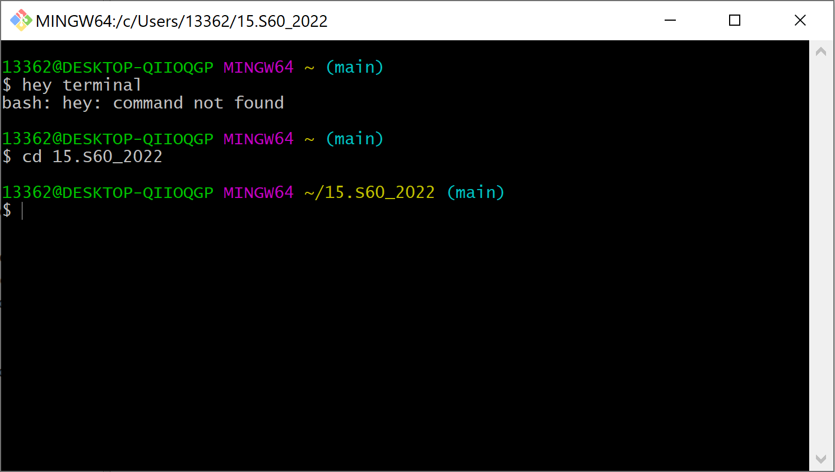
What is the terminal?
The terminal/Unix shell is a text-based interface to interact with the computer.
Notes:
Another way to interact with a computer besides graphical user interface + mouse. Terminal scales much better to certain tasks where lots of repetitive clicking would be necessary.

Slide 15






Why use the terminal?
Athena
Engaging
Repetitive tasks, like “delete all files in a directory ending in .csv”
Chain commands across programming languages sequentially
Access to client servers and computing clusters with Secure Shell (SSH)
We must learn a few basic commands to interact!

Slide 16
Learning Objectives - Terminal
At the end of the session, students will be able to…
Navigate directories and manipulate files using terminal commands
Recognize scenarios when it is necessary or more efficient use the terminal rather than a graphical interface

Slide 17




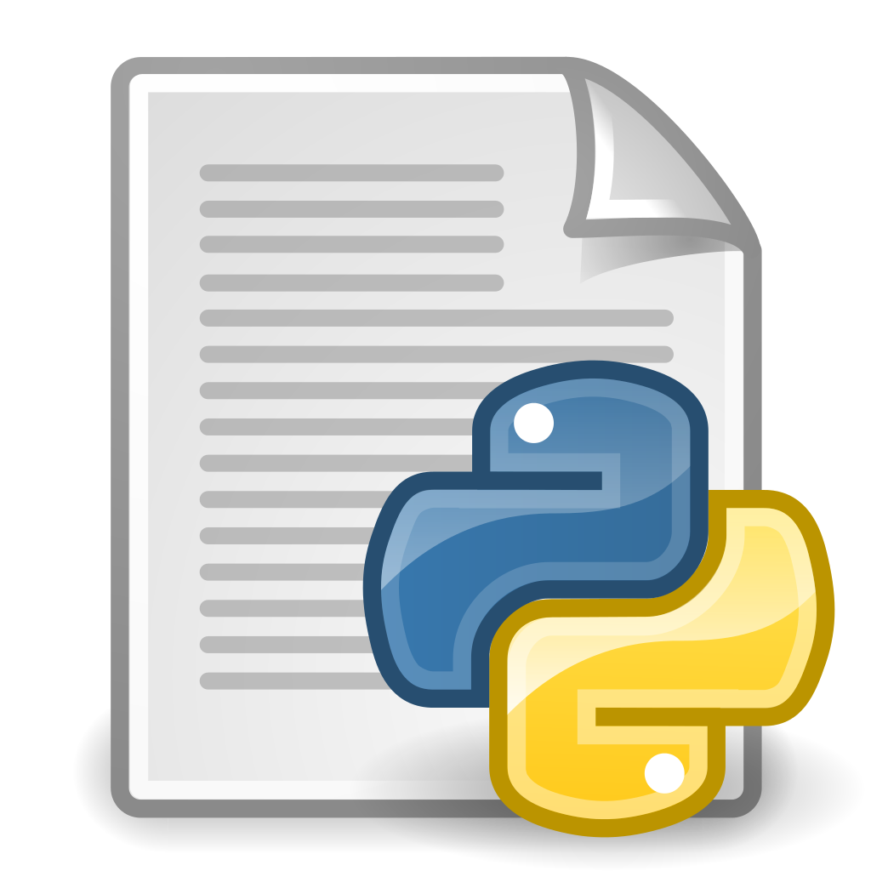
Files and Directories
Users
Working directory
Public
leverest
Downloads
Desktop
Absolute path: /Users/leverest/Desktop/15.S60_2026/data.csv
Relative path:
Desktop/15.S60_2026/data.csv
15.S60_2026
data.csv
stuff.txt
script.py

Slide 18
Terminal Basics
We are using a shell called bash. This program will interpret and process the commands you input into the terminal.
A typical command looks like:
command <argument1> <argument2> …
To open:
Mac users open Terminal
Windows users open Git Bash (installed in the pre-assignment)

Slide 19
Navigating – Commands
Working directory
Users
pwd
>> /Users/leverest
Public
leverest
Downloads
Desktop
15.S60_2026
data.csv
stuff.txt
script.py

Slide 20
Navigating – Commands
Working directory
Users
pwd
>> /Users/leverest
cd Desktop
Public
leverest
Downloads
Desktop
15.S60_2026
data.csv
stuff.txt
script.py

Slide 21
Navigating – Commands
Working directory
Users
pwd
>> /Users/leverest
cd Desktop
Public
leverest
cd 15.S60_2025
Downloads
Desktop
15.S60_2026
data.csv
stuff.txt
script.py

Slide 22
Navigating – Commands
Working directory
Users
pwd
>> /Users/leverest
cd Desktop
Public
leverest
cd 15.S60_2025
ls
>> data.csv
stuff.txt
script.py
Downloads
Desktop
15.S60_2026
data.csv
stuff.txt
script.py

Slide 23
Navigating – Commands
Working directory
Users
Public
leverest
Downloads
Desktop
(“Up” or “back” one level)
cd ..
15.S60_2026
data.csv
stuff.txt
script.py

Slide 24
Navigating – Commands
Working directory
Users
Public
leverest
(“Up” or “back” two levels)
cd ../..
Downloads
Desktop
(“Up” or “back” one level)
cd ..
15.S60_2026
data.csv
stuff.txt
script.py

Slide 25
Navigating – Commands
Working directory
(Back to home directory)
Users
cd
Public
leverest
(“Up” or “back” two levels)
cd ../..
Downloads
Desktop
(“Up” or “back” one level)
cd ..
15.S60_2026
data.csv
stuff.txt
script.py

Slide 26
Navigating – Commands
Print working directory
pwd
List contents of working directory
ls
List contents of specified directory
ls <directory_name>
Change to a new directory
cd <directory_name>
Return to “home” directory
cd
Open a file (analogous to double clicking)
open <filename>

Slide 27
Navigating – Commands 2
Reference current working directory
.
Reference parent of current working directory
..
Reference home directory
~
Navigate history of previous commands using up and down arrow keys
Use tab to autocomplete commands and paths

Slide 28

Poll Question
https://pollev.com/lisaeverest255
If our current working directory is Users/Alex/Documents, which commands would take us back to the home directory, Users/Alex? (select all that apply)
A.)
cd ..
B.)
cd ../..
C.)
cd ~
D.)
cd .
E.)
cd

Slide 29
Poll Question
https://pollev.com/lisaeverest255
If our current working directory is Users/Alex/Documents, which command would take us back to the home directory, Users/Alex?
A.)
cd ..
B.)
cd ../..
C.)
cd ~
D.)
cd .
E.)
cd

Slide 30
File Manipulation – Commands
Create a new directory
mkdir <directory_name>
Create a new file
touch <filename>
Delete a file (cannot be undone!)
rm <filename>
Delete a directory (cannot be undone!)
rm -r <directory_name>
nano <filename>
vim <filename>
Edit file contents (Nano, vim are text editors)
Print contents of a file
cat <filename>
Move or rename a file
mv <source_filename> <target_filename>
Notes:
Notepad or textedit

Slide 31
Demo – Navigation
1. Open Terminal (MacOS) or Git Bash (Windows)
2. Navigate to the class directory from the pre-assignment
cd 15.S60_2026
3. Pull the class Github to get any updates
git pull
4. Navigate to the class directory from the pre-assignment
cd 1_terminal_and_git
5. Print off the list of files in that directory
ls
6. Navigate back to your home directory
cd or cd ~ or cd ../..

Slide 32
File Manipulation – Demo
We want to create a new directory called mydirectory, navigate to it, add a new file called myfile.txt, then add a line of text to the file.
1. Create and navigate to a new directory
mkdir mydirectory
cd mydirectory
2. Add and open a new file for editing
touch myfile.txt
nano myfile.txt
OR
vim myfile.txt
Add some text
Save (Ctrl+O), and exit Nano (Ctrl+X)
OR
Command interface (Esc), and save and exit (:wq)

Slide 33
File Manipulation – Try it out
We want to create a directory within mydirectory called data, navigate to it, add a new file called mydata.csv. Then navigate back to mydirectory.
1. Within mydirectory, create and navigate to a new directory
mkdir data
cd data
2. Add a new CSV file
touch mydata.csv
3. Navigate back to mydirectory
cd ..

Slide 34
Redirecting Outputs
Run a script
Send the output log to a file (rather than the terminal)
python processStuff.py > outputfile.txt

Slide 35
Redirecting Outputs
Run a script
Send the output log to a file (rather than the terminal)
Overwrite / create file
Append to file
<command> > outputfile.txt
<command> >> outputfile.txt

Slide 36
Redirecting Outputs - Demo
I can create a Python script in mydirectory called myscript.py. I can then run it and direct the output to a file called scriptoutput.txt.
1. Create new Python script
vim myscript.py
2. Redirect the output
python myscript.py > scriptoutput.txt
3. Check the output:
cat scriptoutput.txt

Slide 37
Redirecting Outputs - Try it out
Print the contents of mydirectory and direct the list to a file called outputfile.txt.
1. Print the contents of the directory and redirect the output
ls > outputfile.txt
2. Check the output:
cat outputfile.txt

Slide 38
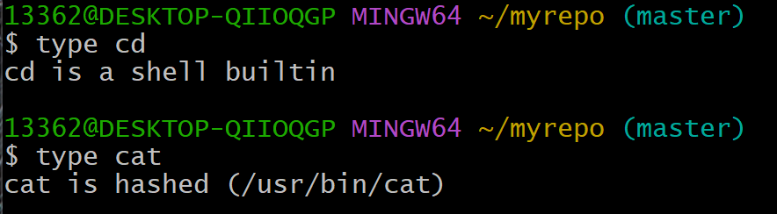
What is Bash actually doing?
Two types of commands, internal (built-in to the shell) and external
When you run an external command like cat, bash looks for a program with that name under the directories listed in the $PATH environment variable and spawns a process that executes the program

Slide 39

More Terminal
There are many more things you can do in Terminal.
readdata.py
makeplots.R
Use multiple programming languages to run sequential processes
Shell scripts to automate chains of commands you use often
Simple pattern matching to find and sort files
If you’re interested, check out the tutorial here: https://swcarpentry.github.io/shell-novice/

Slide 40
Break
Resume at 10:00
Attendance survey:
bit.ly/3IC6Rg8

Slide 41
Git
Adapted from slides by Galit Lukin and Jackie Baek
with activities from Turing Way and Software Carpentry

Slide 42
Learning Objectives – Git/Github
At the end of the session, students will be able to:
Maintain a version control history with appropriate documentation
Contribute to a project with shared code
Share and contribute code to the broader community

Slide 43
Git and Github
Github - Hosting platform for version control and collaboration
Widely used by developers to store their projects
Easily share code and data, privately and publicly
Git - The version control system itself
Command line tool
Used to make local code changes and communicate those changes with Github
Notes:
The next tool is of particular importance if you’re working on computational research or any project with shared code.
Github is a hosting platform for version control and collaboration. It’s helpful when many people are developing code for a shared project and they want to maintain a version history, discuss changes before they are made, and to keep a “production” version of code running while new features are being developed.
Many people use it to make new algorithms and methods widely available by posting code and data publicly. It can also be used to make your code open source, allowing people from all over the world to view your code and suggest changes and additions, which you can then review and accept.
Git is the distributed version control system itself, and Github is the hosting service designed to help you manage your repositories.

Slide 44


Why use version control (Git)?
code.py
code.py
code.py
code.py
If only I could go back to a version that was working…

Slide 45
Why use version control (Git)?
code.py
code.py
code.py
code.py
code_v3.py
code_v4.py
code_v1.py
code_v2.py
What changed between versions? Which version to go back to? What if it’s been months since I worked on this? What if my project has many files?

Slide 46

High-Level Idea
Benefits:
Snapshot of entire repo, not one file
Git stores commit messages
Commits are lightweight
Can go back to previous commits
repository (aka repo)
Initial commit
Add client data files
Fix initial solution for IP
Refactor data cleaning process
Change graph color scheme

Slide 47
Create a repository - Commands
1. Create a new directory for your repo
mkdir <directory_name>
2. Navigate to the directory
cd <directory_name>
3. Initialize repository (you only need to do this once for each repo you create)
git init
Notes:
git config user.email "alexandriaschmid3@gmail.com«
git config user.name Alex Schmid"

Slide 48
Initialize a Git Repo - Demo
Let’s turn mydirectory into a git repo.
1. Navigate to a mydirectory if you aren’t already there
cd mydirectory
2. Initialize the git repo
git init

Slide 49
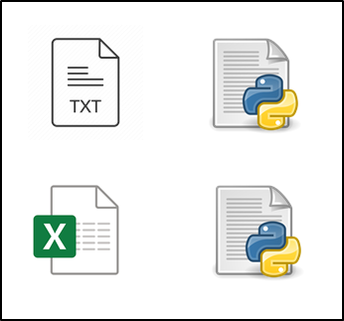
Add and commit
local repository
working directory
staging area
commit n+1
commit n
commit 2
Your local changes that you want to get “permanently” added to local repository
commit 1
Local repository, plus
your local changes

Slide 50
Add and commit
newly-updated local repository
local repository
working directory
staging area
commit n+1
commit n
commit 2
Your local changes that you want to get “permanently” added to local repository
commit 1
Local repository, plus
your local changes
Local repository, plus
your local changes
git add
git commit

Slide 51
Add and commit - Commands
1. Make changes in working directory
2. Check the files in the staging area and any “untracked” changes (not yet added)
git status
3. As you change files: working directory → staging area
git add <filename>
git add . (adds all files)
4. Once you have added a new functionality/completed an update: staging area → local repo
git commit –m “comment”
Add a short, intuitive comment describing the change in functionality
→ For reference later!

Slide 52
Question
In your opinion, which would be the most helpful commit message three months from now? (somewhat subjective!)
A.)
“Fix bug”
B.)
“Add functions: cleanData, processData, runPredictions”
C.)
“Add function to plot model results”
D.)
“Write latest optimization model”

Slide 53
Add and commit - Demo
Let’s commit something to mydirectory! Run git status between each step to see the staging area.
1. Check the current status
git status
2. Add the file to the staging area
git add myfile.txt
git status
3. Commit the changes to the repository
git commit –m “Initial commit for my file”
git status

Slide 54
Add and commit - Try it out
We want to create a new repository called myrepo (outside of mydirectory), create a text file in myrepo called myfile.txt, and add and commit it to the repository.
1. Leave mydirectory. Create and navigate to a new directory and initialize Git.
cd ..
mkdir myrepo
cd myrepo
git init
2. Create an empty text file in myrepo
touch myfile.txt
3. Add and commit the text file to your new repository
git add myfile.txt
git commit –m “Add first text file”

Slide 55
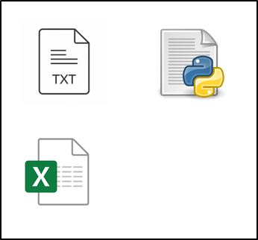
Reverting Changes
local repository
working directory
staging area
commit n+1
commit n
commit 2
commit 1

Slide 56
Reverting Changes
local repository
working directory
staging area
commit n+1
commit n
git checkout
commit 2
commit 1

Slide 57
Reverting Changes
local repository
working directory
staging area
commit n+1
commit n
git checkout
commit 2
commit 1

Slide 58
Reverting Changes - Commands
See log of commits, including SHA ID for each version
git log
Return to a previous version of a file from the commit history
git checkout <version_SHA>
git checkout <version_SHA> <filename>
See differences between two commits or differences in a specific file from two commits
git diff <version1_SHA> <version2_SHA>
git diff <version1_SHA:filename> <version2_SHA:filename>
Notes:
SHA – id for each commit, usually a long string of letters and numbers. We don’t have to use all numbers of the SHA ids, usually the first 7 digits is enough for most projects.

Slide 59
Reverting Changes - Try it out
Add some text to myfile.txt and commit. Check the log of commits, look at the differences between our two commits so far, and then check out the first commit.
Edit and add some text to myfile.txt and commit changes.
vim myfile.txt
git add myfile.txt
git commit –m “Add some text”
2. View the log to see our commit history
git log
3. Find the differences between the two commits (The first 7 digits of the SHA id should be sufficient)
git diff 1093106 976686d
4. Check out the previous commit
git checkout 976686d
(Note this will put you in “detached HEAD” state, which you can get out of with:
git checkout main

Slide 60
Branching
main branch
git checkout
HEAD
branch_1
Suppose you run a process for a client every morning.
You want to make a change, but it will take a few days.
How can you work on the change AND run the stable version?
Notes:
You can create new branches of development in the Github to experiment with new features without affecting the main branch. Your collaborators can then view your branch and branch off of it themselves.

Slide 61
Branching
Branch when the intention is to eventually “merge” the branch back in with main
main branch
git checkout
git merge
HEAD
branch_1
Suppose you run a process for a client every morning.
You want to make a change, but it will take a few days.
How can you work on the change AND run the stable version?
Notes:
You can create new branches of development in the Github to experiment with new features without affecting the main branch. Your collaborators can then view your branch and branch off of it themselves.

Slide 62
Branching and Merging - Commands
See all branches
git branch
Create and navigate to a new branch
git checkout -b new_branch_name
Switch between branches
git checkout branch_name
git checkout branch_receiving_changes
git merge branch_giving_changes
Merge two branches
Delete a branch
git branch –d branch_name

Slide 63
Branching - Demo
Create a new branch called my_branch, add a file called mynewfile.txt to my_branch and commit, and look at the list of branches and log of commits.
1. Create and check out a new branch (one step)
git checkout -b my_branch
2. Add a new file to the new branch
Best practice: check the status between adding and committing
touch mynewfile.txt
3. Add the new file to staging area and commit
git status
git add mynewfile.txt
git commit –m “Add a second text file”
4. Display the branches, then look at the log of commits
git branch
git log

Slide 64
Merging - Demo
Navigate to the main branch, merge my_branch into main, and delete my_branch.
1. Navigate to the main branch
git checkout main
2. Merge my_branch into the main branch
git merge my_branch
3. Delete my_branch
git branch –D my_branch

Slide 65
Multiple Branches
HEAD – the most recent commit on the current branch
main branch
branch_2
HEAD
HEAD
branch_1
Best practice: name the branch related to the changes that you make (in industry, it is typical to name it with the ticket # and a brief description, e.g. SRC544_fixsearchbar)
branch_3
Notes:
You can create new branches of development in the Github to experiment with new features without affecting the main branch. Your collaborators can then view your branch and branch off of it themselves.

Slide 66
Multiple Branches
HEAD – the most recent commit on the current branch
main branch
HEAD
branch_2
git checkout
HEAD
branch_1
branch_3
Notes:
You can create new branches of development in the Github to experiment with new features without affecting the main branch. Your collaborators can then view your branch and branch off of it themselves.

Slide 67
Multiple Branches
HEAD – the most recent commit on the current branch
HEAD
main branch
branch_2
git checkout
HEAD
branch_1
branch_3
Notes:
You can create new branches of development in the Github to experiment with new features without affecting the main branch. Your collaborators can then view your branch and branch off of it themselves.

Slide 68
Multiple Branches
HEAD – the most recent commit on the current branch
HEAD
HEAD
main branch
git merge
branch_2
HEAD
branch_1
branch_3

Slide 69
Aside: ‘detached HEAD’ state
HEAD usually points at a branch directly. When you checkout a commit, HEAD instead points directly at that commit. This is a ‘detached HEAD’ state. That’s okay!
main
branch_2
HEAD
HEAD
branch_1

Slide 70
Aside: ‘detached HEAD’ state
HEAD usually points at a branch directly. When you checkout a commit, HEAD instead points directly at that commit. This is a ‘detached HEAD’ state. That’s okay!
HEAD
main
branch_2
Options:
Make changes and commit
Checkout a branch
git checkout
HEAD
HEAD
branch_1

Slide 71
Branching – Try it out
Checkout the main branch. Then checkout an earlier commit to enter a detached HEAD state. Create a new branch called new_feature. Check out the main branch.
1. Checkout main, view log, and checkout an earlier commit
git checkout main
git log
git checkout 976686d
2. Create a new branch from this commit
git checkout –b new_feature
3. Display the branches, checkout main, then look at the log of commits
git branch
git checkout main
git log

Slide 72

‘detached HEAD’ state
git checkout
(detached) HEAD
HEAD
main
git checkout -b
git checkout
HEAD
HEAD
new_feature
Notes:
You can create new branches of development in the Github to experiment with new features without affecting the main branch. Your collaborators can then view your branch and branch off of it themselves.

Slide 73
Merge Conflicts
When merging changes, we may sometimes find that our branches conflict.
code.py
main
code.py
code.py
???
branch_1

Slide 74
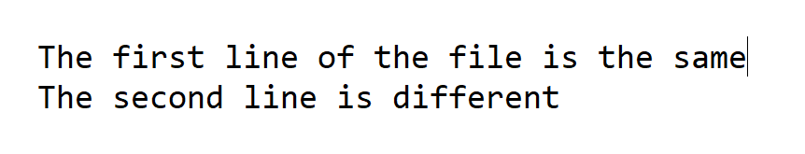
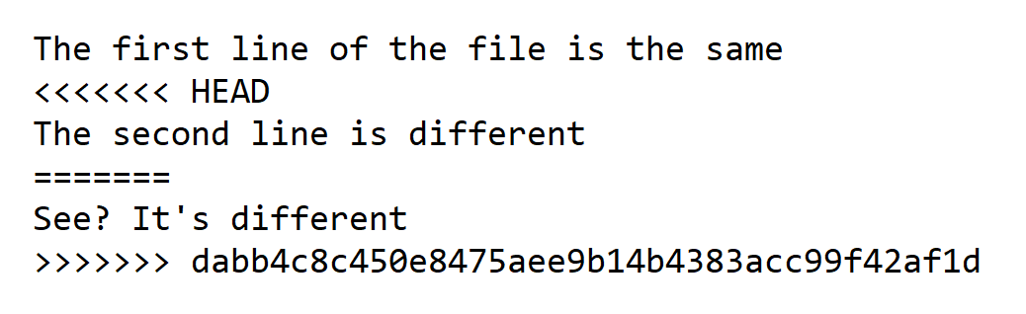
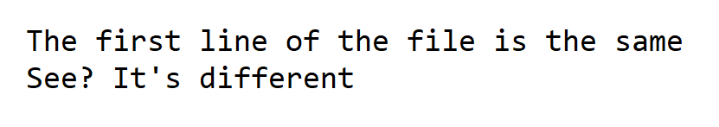
Merge Conflicts
HEAD
Commit dabb4c8c
When this happens, Git shows you exactly what the conflicts are and where they are located. It is up to you to reconcile the conflicts and commit them.

Slide 75
Merge Conflict – Demo (code along!)
Add text to myfile.txt in main and commit. Navigate to the new_feature branch, add different text to myfile.txt, and attempt to merge new_feature into main.
1. Add text to myfile.txt and commit to main
git checkout main
nano myfile.txt
git add myfile.txt
git commit –m “Add some text”
2. Add different text to myfile.txt in new_feature and commit
git checkout new_feature
nano myfile.txt
git add myfile.txt
git commit –m “Add different text”

Slide 76
Merge Conflict – Demo (code along!)
Add text to myfile.txt in main and commit. Navigate to the new_feature branch, add different text to myfile.txt, and attempt to merge new_feature into main.
3. Navigate to the main branch and merge new_feature branch
git checkout main
git merge new_feature
4. Resolve merge conflict
nano myfile.txt
5. Commit changes to main
git add myfile.txt
git commit –m “Resolve myfile conflict”

Slide 77
Question
Suppose you create a new branch and add a file, branchfile.txt, and commit. You then add a file, mainfile.txt, to the main branch and commit. When you try to merge, your branch to main, what do you expect to happen?
A.)
Merge successful! Both files exist in main
Merge successful! But main now holds only branchfile.txt but not mainfile.txt
B.)
C.)
Merge conflict, you must resolve

Slide 78
Question
You add a file, community.txt, to the main branch and commit. You then create a new branch and add a file, branchfile.txt, and commit. You then delete community.txt from main and commit. You make changes to community.txt on the new branch. When you try to merge your branch to main, what do you expect to happen?
A.)
Merge successful! And branchfile.txt exists in main
Merge successful! But branchfile.txt does not exist in main
B.)
C.)
Merge conflict, you must resolve

Slide 79
Git Wrap-Up
Commit often, write descriptive messages, and keep each commit to one “atomic” task
→ Almost anything can be undone, as long as it’s committed
Take advantage of branching when you have new lines of development and don’t want to disrupt the functionality of the main branch
Google is your friend (e.g. “How to undo commit in Git”.)

Slide 80
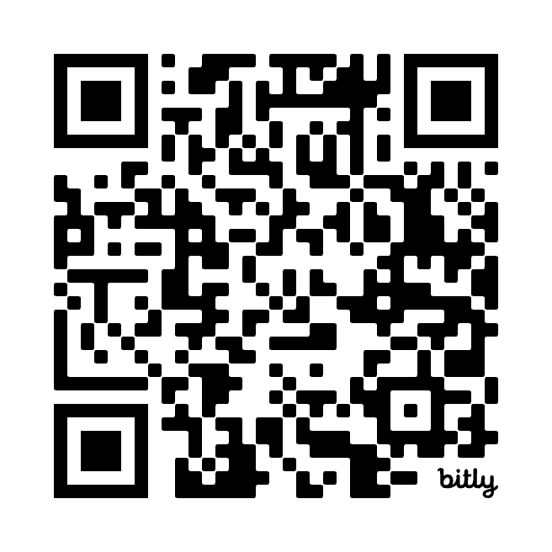
Break
Resume at 10:25
Attendance survey:
https://bit.ly/15s60_s7

Slide 81
Github
Adapted from slides by Galit Lukin and Jackie Baek
with activities from Turing Way and Software Carpentry

Slide 82

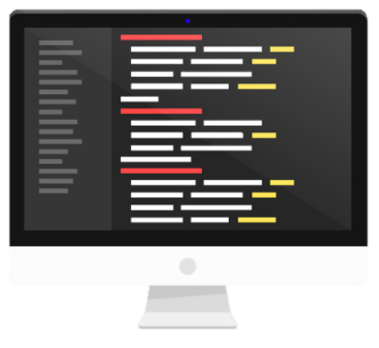

Why use Github?
You’re working on a research project with another graduate student and both have access to the code in a shared space, e.g. Dropbox.
Shared Code
Shared Code
Download
Re-upload
Original
A
Version A
B
Version B
What are some potential problems that could arise using this process?
Notes:
What does Github allow you to do? Let’s say you’re working on a research project with another graduate student. You’re analyzing a large dataset and using the data to make some predictions about your problem. You all have access to the code in a shared space. You want to make a change to the data cleaning and your collaborator wants to make changes to the prediction algorithm. You both make your changes on your local computers, then want to update the shared version of the code so you upload a new version. What are some potential problems that could arise with this process?
[How do you stay up to date with the changes the other person is making?]
[What if you both updated the same section of the code? How to reconcile conflicts?]
[What if your bits of code no longer work together?]
[What if you overwrite each other’s work?]
[What if the code breaks and we want to see what changed from a previous version?]
These are all issues that Git and Github are designed to address. We want a way to collaborate on code that keeps everyone up to date on changes and documentation, makes it easy to reference earlier versions, provides a way to merge changes made by different people, and allows us to maintain one source of “truth” in the code while still editing code on our own.

Slide 83
Why use Github?
You’re working on a research project with another graduate student and both have access to the code in a shared space, e.g. Dropbox.
Shared Code
Shared Code
Download
Re-upload
Original
A
Version A
B
Version B
Potential issues: Documenting all changes, staying up to date with changes, overwriting others’ work, conflicts between versions, etc.
Notes:
What does Github allow you to do? Let’s say you’re working on a research project with another graduate student. You’re analyzing a large dataset and using the data to make some predictions about your problem. You all have access to the code in a shared space. You want to make a change to the data cleaning and your collaborator wants to make changes to the prediction algorithm. You both make your changes on your local computers, then want to update the shared version of the code so you upload a new version. What are some potential problems that could arise with this process?
[How do you stay up to date with the changes the other person is making?]
[What if you both updated the same section of the code? How to reconcile conflicts?]
[What if your bits of code no longer work together?]
[What if you overwrite each other’s work?]
[What if the code breaks and we want to see what changed from a previous version?]
These are all issues that Git and Github are designed to address. We want a way to collaborate on code that keeps everyone up to date on changes and documentation, makes it easy to reference earlier versions, provides a way to merge changes made by different people, and allows us to maintain one source of “truth” in the code while still editing code on our own.

Slide 84
High-Level Idea
main
remote repository
git clone
git push
local repository

Slide 85
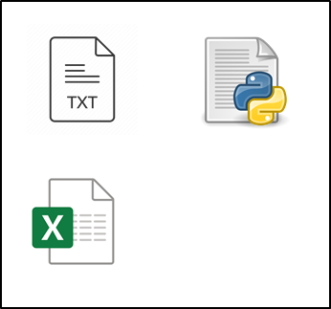
Local and Remote Repositories
remote repository
local repository
git remote add

Slide 86
Local and Remote Repositories
Your collaborator’s
local repository
remote repository
git clone
B

Slide 87
Local and Remote Repositories
Your collaborator’s
local repository
remote repository
git clone
git push
B

Slide 88
Local and Remote Repositories
YOUR
local repository
remote repository
git pull
git push

Slide 89
Local and Remote - Commands
Add a remote connection to a Github repo for an existing local repo
git remote add origin <Github SSH>
Clone existing Github repo
git clone <Github URL>
Pull from Github repo to local repo
git pull
Push from local repo to Github repo
git push origin <branch_name>
Local machine’s name for the remote repo (origin is usual convention)

Slide 90
Cloning a Github repo - Try it out
Clone the class repo into the location of your choice.
1. Navigate to wherever you cloned the repo (or already cloned the repo)
cd ~/courses/
2. Clone the Github repository to your machine or pull changes if you already cloned it
git clone https://github.com/leverest/15.S60_2025.git
- or -
cd 15.S60_2025
git pull
3. Find it on your computer and check it out! You should see the module for this session (or change your directory and type ls )
Notes:
git config user.email "alexandriaschmid3@gmail.com«
git config user.name Alex Schmid"

Slide 91
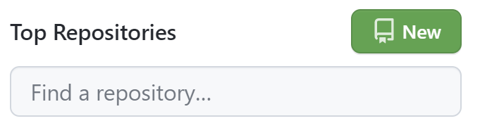
Creating a Github repo through Github
Create your own repository in Github called myrepo (we’ll walk through this together).
1. Go to github.com and login
2. Click “New” in the top left by your list of repositories and fill in details
3. Clone the Github repository to your machine [skip this step for now]
git clone https://github.com/<username>/<reponame>.git

Slide 92
Creating a Github repo for existing local repo
Create a remote connection for myrepo
1. Navigate to the existing repo (from the Git part of class)
cd mydirectory
2. Add a remote connection
git remote add origin <Github HTTPS>
3. Push to upstream to Github
git push -u origin main

Slide 93
Pushing to Github - Demo
Create a new file mynewfile.txt, add some text, commit locally and push changes to Github.
1. Create a new file and add a line of text
touch localfile.txt
nano localfile.txt
git add localfile.txt
git commit –m “Add file to local repo”
git push origin main
2. Commit the changes locally
3. Push the changes to Github

Slide 94
Merge conflicts with Github
Your collaborators may have pushed new changes to Github while you’ve been working on your own changes locally.
Best practices:
Pull from Github often, even when you aren’t making changes to the remote repo
Pull right before you push your changes
Resolve merge conflicts as they arise when you pull
For example,
git commit –m “Fix bug”
git pull
git push origin main

Slide 95
Basic Workflow (Option 1)
Create a new local branch called new_branch, add some text to newfile.txt on new_branch and commit, merge the changes into main, pull any new changes from Github, and push to Github.
Step-by-step:
git checkout -b new_branch
nano mynewfile.txt
git add mynewfile.txt
git commit –m “Adding a text file”
git checkout main
git merge new_branch
git pull
git push origin main

Slide 96
Basic Workflow (Option 1)
When do you make a commit?
Think “atomic”
Single bug fix, feature, re-factor
Create repo
Clone from Github
Get repo
Create commits
Make changes
Stage changes
Make commit
When do you push to Github?
Completed and tested feature, ready for use or review
Merge with remote
Pull from Github
Resolve conflicts
Make commit
Update remote
Push to Github

Slide 97
Basic Workflow (Option 1)
When should I branch?
May need to run main
When you and a collaborator are working on different things
Why might I push my branch to Github?
If you want to collaborate on the branch
As a code back-up!
Create repo
Clone from Github
Get repo
Create commits
Make changes
Stage changes
Make commit
Merge with remote
Pull from Github
Resolve conflicts
Make commit
Update remote
Push to Github

Slide 98
Social Coding Workflow (Option 2)
Thus far, we’ve focused on using Github with a small group of people who have shared access to a repository.
How can you contribute to projects in the broader Github community?
Not everyone has repo access, so we can’t just push our changes
Repository owner has a reviewing mechanism

Slide 99
Social Coding Workflow (Option 2)
Create a new local branch called new_branch, add some text to newfile.txt on new_branch and commit. Pull any new changes from Github from main into new_branch. Push new_branch to Github and make a pull request.
Step-by-step:
git checkout -b new_branch
nano mynewfile.txt
git add mynewfile.txt
git commit –m “Adding a text file”
git push origin new_branch
<make ”pull request” on Github>

Slide 100

How to submit a pull request on Github
Navigate to your repository on Github and switch to this tab:
Click “New pull request” and follow prompts

Slide 101
Another Workflow – Forking / Pull Requests
main
accept and merge
Repo owner/ reviewer
fork
pull request

Slide 102

How to fork a repo on Github
Fork a repository from Github and clone your forked copy onto your local machine.
1. Go to github.com, login, and find the repo you want to clone
2. Click “Fork” in the right of the repo page
3. Clone the forked Github repository to your machine
git clone https://github.com/<yourusername>/<reponame>.git

Slide 103
Cloning vs. Forking
Clone
Creates a local copy of the repo
Execute in terminal with git
Fork
Creates a copy of the repo on Github
Execute in Github
clone
fork
local repository

Slide 104
Question
Your collaborator gave you access to a repository that contains shared code. You want to be able to make your own changes and push them to the Github repo.
Should you clone or fork the repository?
A.)
Clone
B.)
Fork
Notes:
Note this was original a poll on PollEV, which has been removed for time purposes.

Slide 105
Question
You found a Github repo and think it would be a great starting point for a project you’re working on.
Should you clone or fork the repository?
A.)
Clone
B.)
Fork (then clone)
Notes:
Note this was original a poll on PollEV, which has been removed for time purposes.

Slide 106
Question
You find a repo on Github that has some room for improvement, but to which you don’t have access.
What would happen if you tried to clone the repository?
A.)
An error. You can’t clone without access.
B.)
Git would create a local copy of the repo, but you couldn’t push changes.
C.)
Git would create a local copy of the repo and you could push changes to the Github repo.
Notes:
Note this was original a poll on PollEV, which has been removed for time purposes.

Slide 107
Putting it all together – Task 1
Fork leverest/putitalltogether and clone it to your local machine. Add a text file with a unique name that contains your name (and a fun fact?) to the students folder and commit. Push changes to your forked repo, then send a pull request to me.
Fork repo on Github
2. On your local machine:
git clone https://github.com/<yourusername>/putitalltogether.git
cd putitalltogether
touch students/<uniquefilename>.txt
nano students/<uniquefilename>.txt
git add students/<uniquefilename>.txt
git commit –m “Add Alex’s text file”
git pull
git push origin main

Slide 108

Putting it all together – Task 1
Fork alexschmid3/putitalltogether and clone it to your local machine. Add a text file with a unique name that contains your name (and a fun fact?) to the students folder and commit. Push changes to your forked repo, then send a pull request to me.
Submit a pull request to me

Slide 109
Putting it all together – Task 2
Get a list of the contents of the students folder and send the output to outputs/studentlist.txt. What do you notice when you run git status? What happens when you try to add and commit changes?
Hint:
Print out the contents of .gitignore file. What do you think this file’s purpose is?
1. Get list of contents and send to outputs
ls students > outputs/studentlist.txt
git add outputs/studentlist.txt
2. More info on gitignore: https://swcarpentry.github.io/git-novice/06-ignore/index.html

Slide 110


LaTeX
Adapted from slides and documents by Arthur Delarue

Slide 111
Learning Objectives
At the end of the session, students will be able to…
Organize and format a simple document in LaTeX, including tables, figures, and bibliography
Add papers to their Zotero library, organize and categorize their papers, link their
account to Overleaf, and directly cite their papers in LaTeX

Slide 112
Motivation
TeX
LaTeX
Donald Knuth created TeX to specify all
kinds of formatting for documents. Includes algorithms to make documents “beautiful” (kerning, spacing, word breaks).
Leslie Lamport released LaTeX (Lamport’s TeX) which includes macros he built on top of TeX. This makes the writing process
more content-focused instead of
formatting-focused.
To create a new “Intro” section:
TeX: Specify larger font, bold, space before and after, section numbering convention, etc.
LaTeX: \section{Introduction}

Slide 113
Benefits of LaTeX
Separate content from formatting: type everything in plain text, then easily adjust formatting afterwards
Easily format a wide range of documents with style templates
Prettiest and easiest way to type up mathematical notation and formulas
Helps keep citations and references in a consistent format

Slide 114




Using LaTeX
TeX distributions
Installed locally on your machine
Greater control of customization and formatting
Fewer privacy concerns for
sensitive documents
Available online with no install needed
Optimized for ease-of-use and a
good place to learn
Allows for easy collaboration, kind of like “Google Docs” for LaTeX

Slide 115
Overleaf Demo
View demo here: https://www.overleaf.com/read/hhdngkdkkcsm

Slide 116
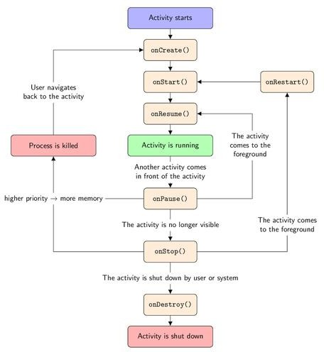
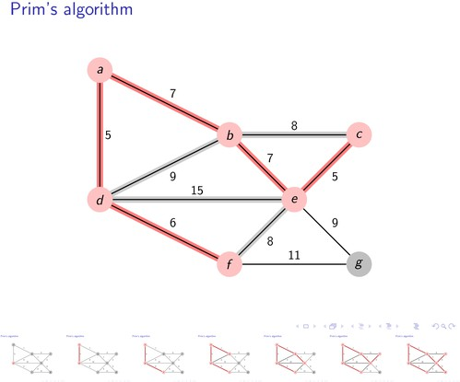
Figures in TikZ
Make paper-ready figures using the TikZ package. Same “modular” formatting principle the rest of LaTeX.

Slide 117
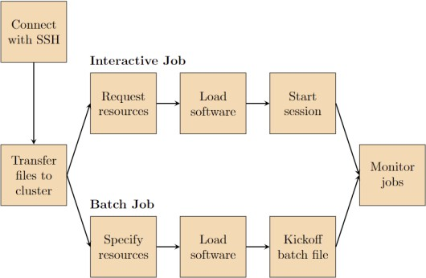
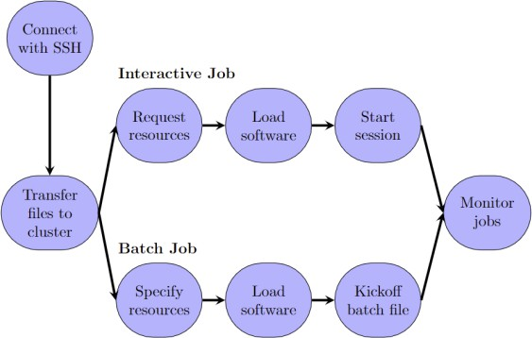
Figures in TikZ
Specify style elements (red rounded boxes, thick black arrows, font size 12, etc.)
Build your figure using the alias of each element (box, arrow, etc.)
Easily change the formatting for all elements with one command, and TikZ will apply the new style to everything

Slide 118
Overleaf and GitHub Integration
You can clone your Overleaf project as a Github repository
Edit your .tex file locally and push changes to Overleaf via Github
More information here: https://docs.overleaf.com/integrations-and-add-ons/git-integration-and-github-synchronization/git-integration/git-integration-authentication-tokens

Slide 119
Key Takeaways
LaTeX allows you to focus on content first, then easily adjust formatting
Use Google to find commands, packages, and templates
LaTeX is widely used: if you’re doing a tedious task, there may be a simple tool to
help if you search! (e.g. generate a large LaTeX table from an Excel table, translate
markdown to LaTeX)

Slide 120
Zotero
Adapted from slides and documents by Alexandria Schmid

Slide 121




Motivation
It can be difficult to keep papers organized, both for specific literature reviews and for your general library
Tools like Zotero, Mendeley, EndNote, and PaperPile are easy to use and can save
lots of time and frustration
Add papers to library
Automatically capture citation information
Organize by project, topic, and tags
Connect to Overleaf to generate bibliographies

Slide 122

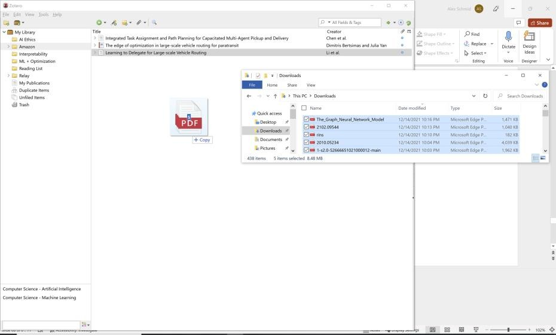

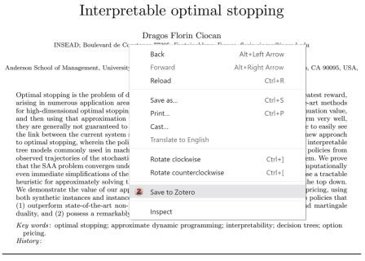
Adding Papers
Download: https://www.zotero.org/download/
Add browser connector to add papers with button in search bar or with right click
Drag downloaded papers into your
Zotero library

Slide 123
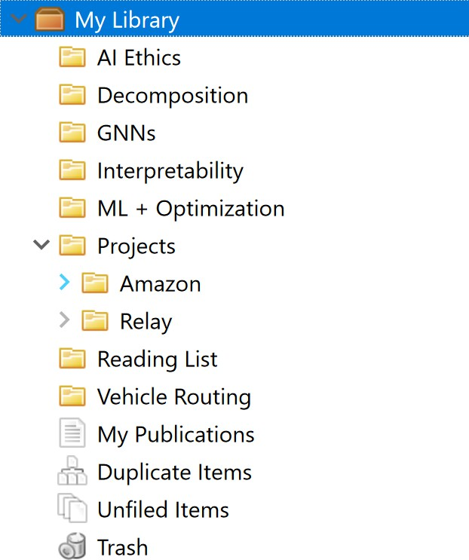
Organizing Your Library
Organize papers into folders
by topic, project, etc.
Organization Tips
Keep a “reading list” to separate papers that you have not read yet and prune the list often. If you add lots of random, unread papers, you may end up with a cluttered and difficult to use library.
Add tags and ensure citations are correct when you first add a paper, otherwise risk doing lots of organizational work later
Link related papers to help jump start
future literature reviews

Slide 124
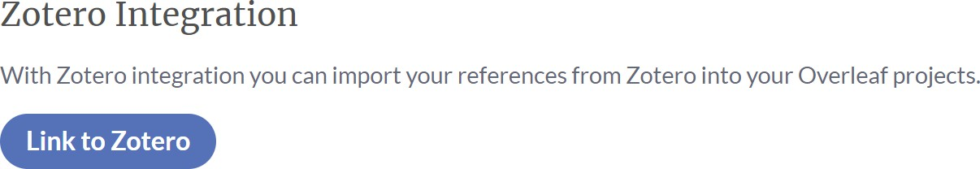

Connecting to Overleaf
Overleaf > Account > Account Settings > Zotero Integration (or Mendeley)
From your project, Upload > Import a .bib file containing your Zotero library

Slide 125
More tips
To change the reference label used in the Zotero BibTeX file for a paper, add “Citation key: <desired label>” to the “Extra” field of the paper’s Zotero info section.
Mendeley also offers Overleaf integration, with the additional feature of allowing you to import BibTeX files for specific folders, rather than your entire library.

Slide 126
Reference, reference, reference!
Now that you’re TeX-savvy™, use your new skills to reference your Zotero papers in LaTeX documents with ease!

Slide 127
NOMAD

Slide 128
What is Nomad?
Nomad is a browser extension that provides you access to MIT Libraries licensed resources and open access articles
Can download here: https://thirdiron.com/downloadnomad/
Select your browser for download and select “Massachusetts Institute of Technology (MIT)” as your organization
Additional support: https://libraries.mit.edu/research-support/connect/

Slide 129
Homework
Due 11:59 pm, Tuesday, Jan 13
Create a LaTeX document
Cite something using Zotero
Start your personal website and practice forking and committing using Git/Github

